Slide 1



Slide 2
Red Laser Steel Cobra Danger Unicorns Presents: “Lack of genetic isolation by distance, similar genetic structuring but different demographic histories in a fig pollinating wasp mutualism” By: Enwai Tian, John D. Nason, Carlos A. Machado, Linna Zheng, Hui Yu and Finn Kjellberg
Jose Lopez, Ashley Paulsen, Lyle Sisson, Jacob Zobrist

Slide 3
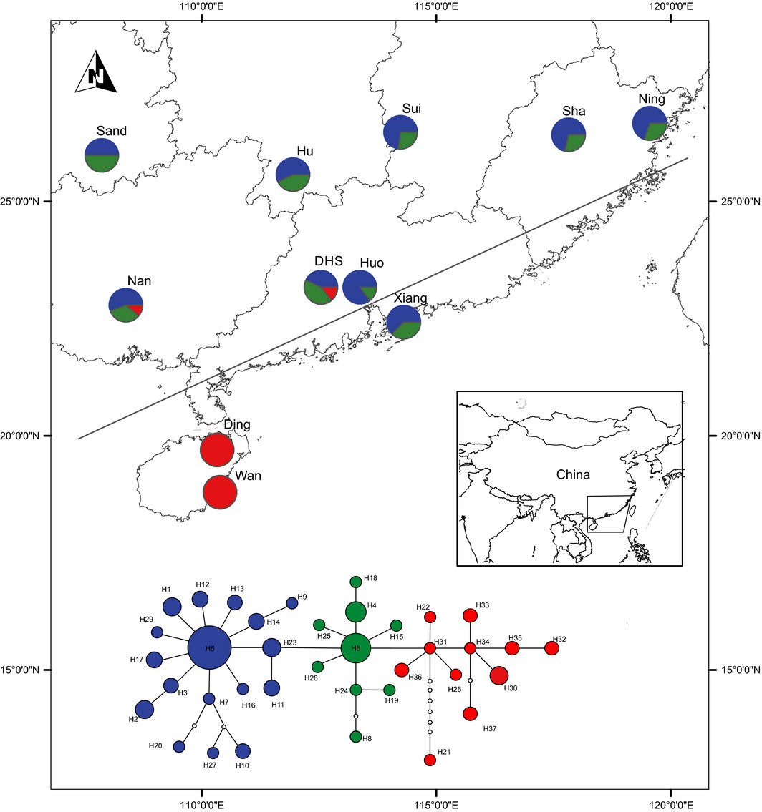
Biological Background and Experimental Design
Spacial and genetic structure was compared between the ficus hirta and Valisia javana
Dispersal of the insect leads to plant and insect presenting similar signatures of lack of genetic isolation
Differentiation for both wasps and fig-tree between the continent
highly dispersive mutualistic systems, isolation-bydispersal limitation across a geographic barrier could be supplemented by isolation by adaptation, and maybe by coevolution, allowing further genetic divergence,
Notes:
dispersal of the insect leads to plant and insect presenting similar signatures of lack of genetic isolation by distance for nuclear genes on the continent over a distance of 1000 km

Slide 4
GenAlEx Format

Slide 5
Codominant Frequency
Graphs and Excel Charts

Slide 6
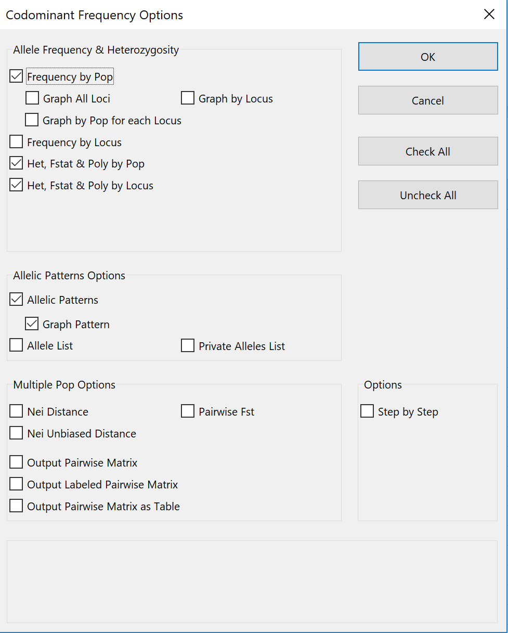
Heterozygosity, F-statistics, and Allelic Patterns

Slide 7
Mean Allelic Patterns Across Populations
Mean values
Population | Ning | Sha | Sui | Xiang | Huo | DHS | Hu | Sand | Nan | Ding | Wan
Na | 5.333 | 5.556 | 5.667 | 5.111 | 6.444 | 6.889 | 6.667 | 7.111 | 6.667 | 8.222 | 5.222
Na Freq. >= 5% | 4.111 | 3.667 | 4.111 | 3.444 | 4.111 | 4.000 | 4.444 | 5.111 | 4.333 | 5.778 | 5.222
Ne | 3.067 | 2.877 | 2.982 | 2.507 | 3.557 | 3.995 | 3.617 | 4.193 | 3.057 | 5.173 | 3.124
I | 1.111 | 1.131 | 1.151 | 1.019 | 1.360 | 1.301 | 1.294 | 1.487 | 1.242 | 1.537 | 1.140
No. Private Alleles | 0.000 | 0.111 | 0.000 | 0.111 | 0.444 | 0.556 | 0.444 | 0.333 | 0.556 | 1.667 | 0.222
No. LComm Alleles (<=25%) | 0.111 | 0.444 | 0.444 | 0.222 | 0.889 | 0.333 | 0.556 | 0.889 | 0.444 | 1.111 | 1.222
No. LComm Alleles (<=50%) | 1.556 | 1.889 | 1.556 | 1.333 | 2.111 | 1.778 | 2.333 | 2.556 | 2.111 | 2.556 | 2.444
He | 0.528 | 0.562 | 0.551 | 0.494 | 0.632 | 0.589 | 0.591 | 0.683 | 0.557 | 0.651 | 0.539
uHe | 0.541 | 0.572 | 0.565 | 0.510 | 0.654 | 0.601 | 0.606 | 0.703 | 0.572 | 0.669 | 0.568
Standard Error (SE) values
Population | Ning | Sha | Sui | Xiang | Huo | DHS | Hu | Sand | Nan | Ding | Wan
Na | 0.986 | 1.132 | 1.155 | 0.857 | 0.959 | 1.419 | 1.344 | 0.964 | 1.280 | 1.942 | 1.038
Na Freq. >= 5% | 0.676 | 0.577 | 0.512 | 0.580 | 0.484 | 0.745 | 0.709 | 0.772 | 0.833 | 0.983 | 1.038
Ne | 0.624 | 0.465 | 0.609 | 0.436 | 0.690 | 1.169 | 0.949 | 0.801 | 0.495 | 1.383 | 0.595
I | 0.223 | 0.192 | 0.201 | 0.186 | 0.177 | 0.244 | 0.229 | 0.177 | 0.234 | 0.281 | 0.240
No. Private Alleles | 0.000 | 0.111 | 0.000 | 0.111 | 0.242 | 0.444 | 0.242 | 0.236 | 0.377 | 0.726 | 0.222
No. LComm Alleles (<=25%) | 0.111 | 0.338 | 0.176 | 0.147 | 0.351 | 0.167 | 0.338 | 0.200 | 0.242 | 0.754 | 0.662
No. LComm Alleles (<=50%) | 0.556 | 0.655 | 0.503 | 0.577 | 0.539 | 0.741 | 0.799 | 0.626 | 0.754 | 1.002 | 0.930
He | 0.100 | 0.082 | 0.083 | 0.082 | 0.069 | 0.087 | 0.087 | 0.056 | 0.099 | 0.092 | 0.099
uHe | 0.102 | 0.083 | 0.085 | 0.084 | 0.072 | 0.089 | 0.089 | 0.057 | 0.102 | 0.094 | 0.104

Slide 8
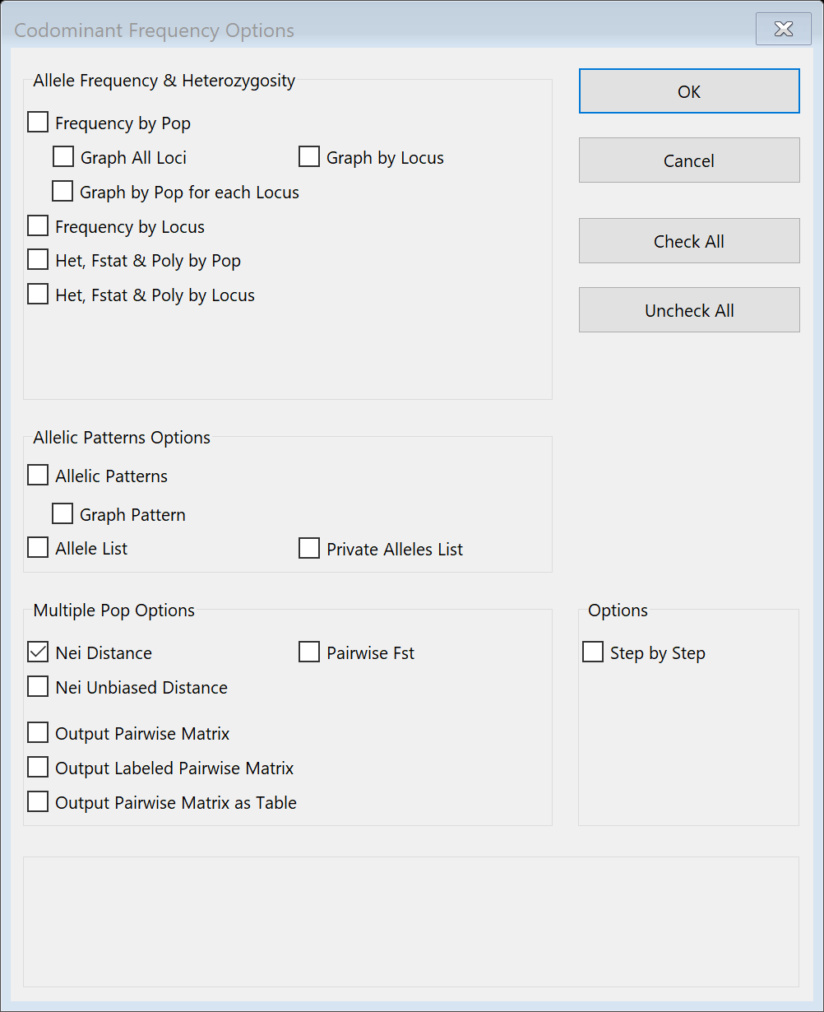
Nei’s Genetic Distance D.
While FST is perhaps the most widely used measure of genetic differentiation among
populations, another frequently used estimate of the genetic difference among populations

Slide 9
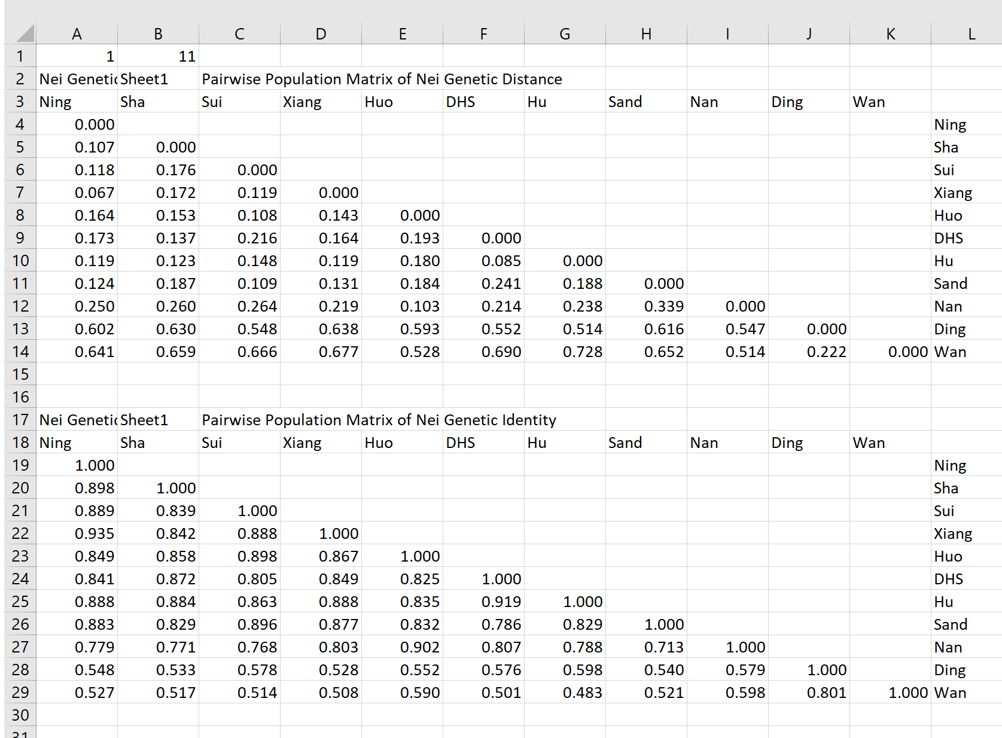

Slide 10

Pairwise F_{st} and Nei Genetic Distances

Slide 11
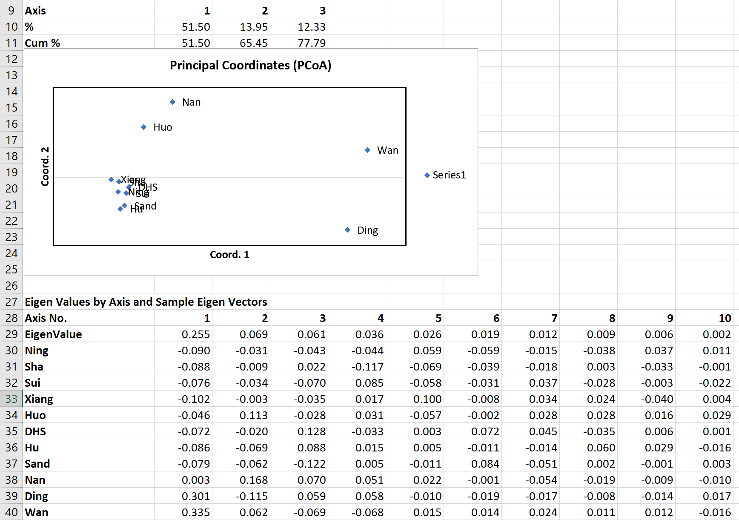
PCoA test from NeiP

Slide 12
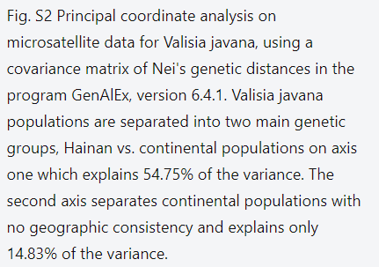
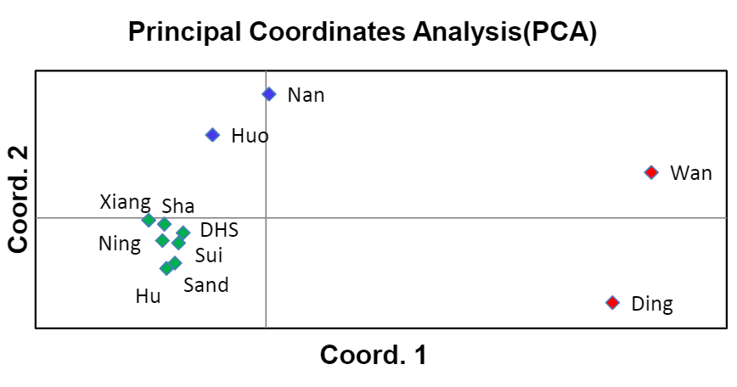

Slide 13
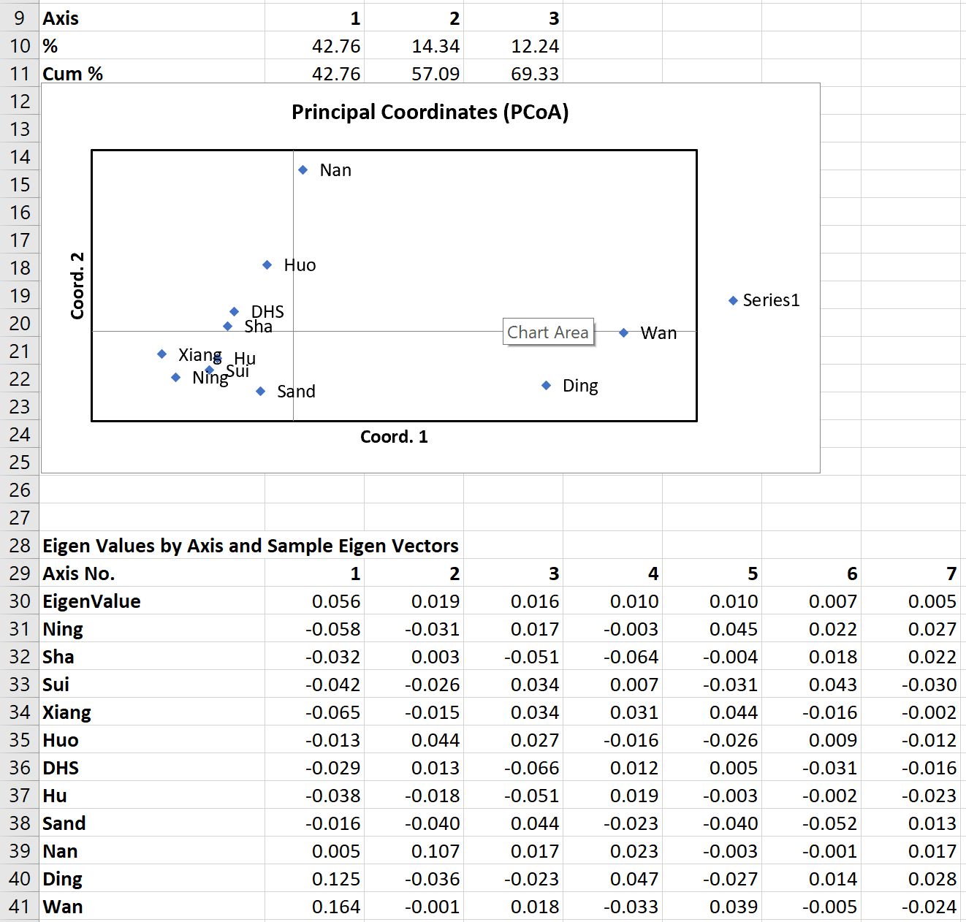
PCoA from F_{ST}P

Slide 14
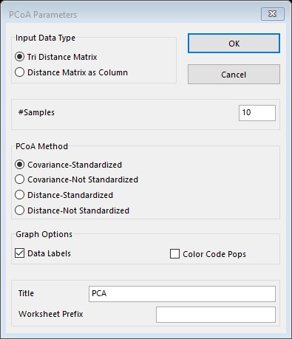
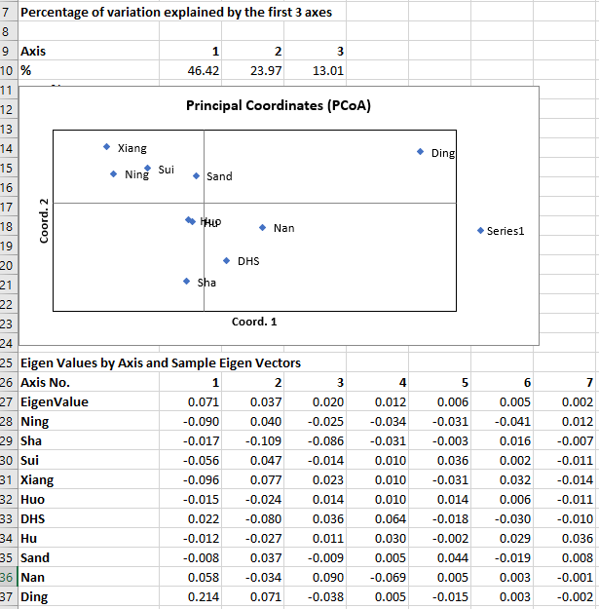
PCoA on PhiPTP

Slide 15
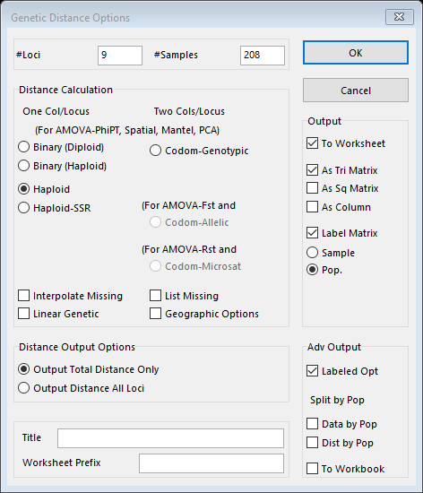
Calculating Haploid Distance

Slide 16
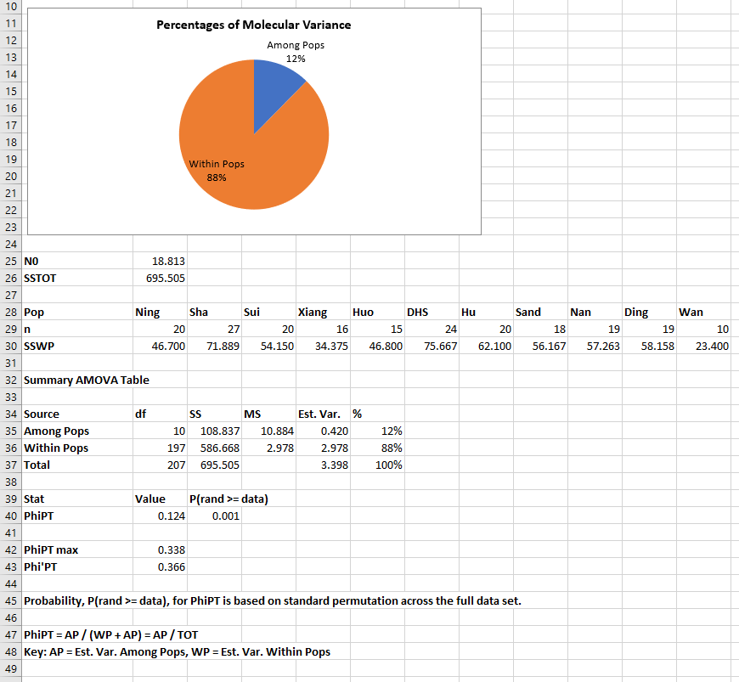
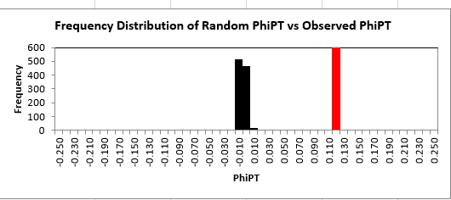
AMOVA Test

Slide 17
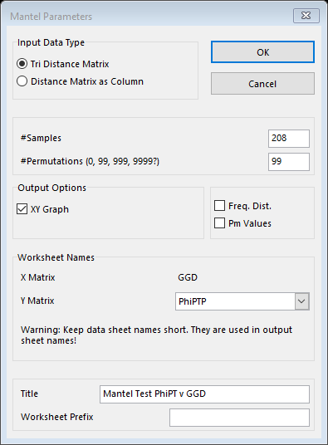
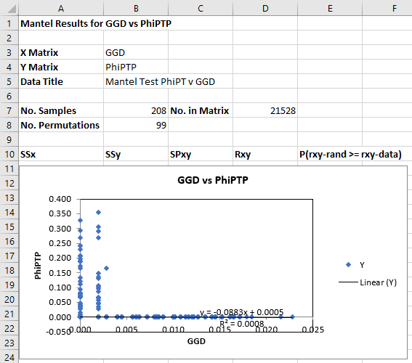
Mantel Tests for Isolation-by-Distance

Slide 18
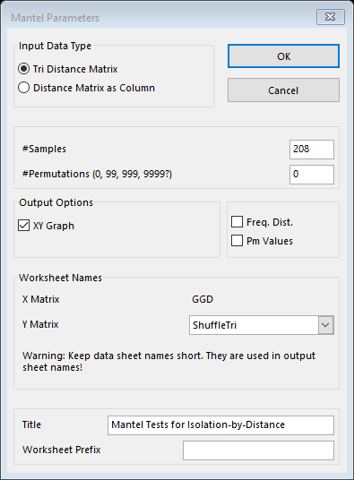
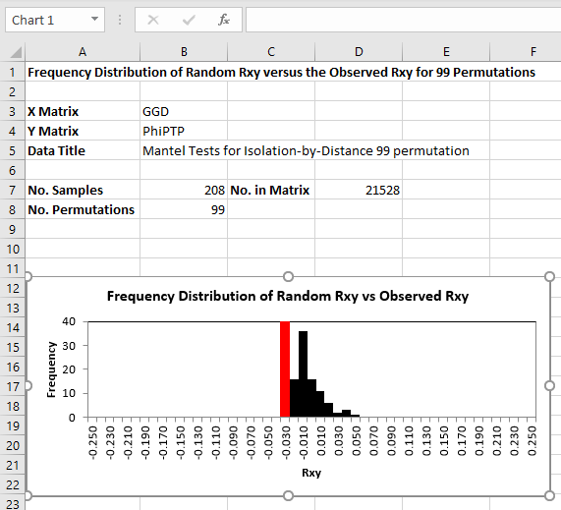
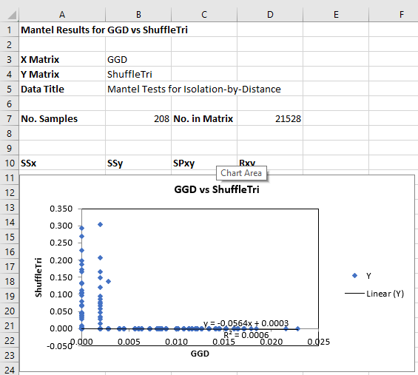
Mantel Tests for Isolation-by-Distance

Slide 19
Analysis and Formatting in R
We had to do a lot of data formatting and I ended up doing most of this in R
The data was given as an microsatellite data in an excel workbook, in what we learned is GenAlEx format, and haplotypes mitochondrial DNA sequences in a text file
These files we not very compatible with most of our software
They also used the Genepop package in R

Slide 20
Some Genepop output
Fst("microsatellite_geno_pop.txt", sizes = FALSE, pairs = FALSE, outputFile = "FST_microsatellite.txt",
dataType = "Diploid", verbose = interactive())
Output
Genepop 4.7.0
Allele frequency-based correlation (Fis, Fst, Fit)
One locus estimates following standard ANOVA as in Weir and Cockerham (1984)
File: microsatellite_geno_pop.txt (Individual_ID )
Number of populations detected : 11
Number of loci detected : 9
Locus: SSR1
---------------------------------
Pop Genotypes:
------------------------------------------------------------------------------------------------------------------------------------------------------------------------------------------------------------------------------------------------
7 1 9 11 7 11 13 11 13 15 13 17 15 13 15
7 9 11 11 13 13 13 15 15 15 17 17 19 23 27 Total
ND20 0 0 0 0 0 2 16 0 1 1 0 0 0 0 0 20
sha27 0 0 0 0 0 2 15 0 4 6 0 0 0 0 0 27
JX20 0 0 0 1 0 2 14 1 0 2 0 0 0 0 0 20
XG16 0 0 0 0 0 1 12 0 2 0 0 0 1 0 0 16
ZWY15 0 1 0 2 0 1 9 0 1 0 0 0 0 0 1 15
DHS24 0 0 0 1 0 2 12 0 5 3 1 0 0 0 0 24
HN20 0 0 0 0 0 2 11 0 4 1 0 1 0 1 0 20
SD20 1 0 1 1 0 3 6 1 1 4 0 0 0 0 0 18
NN19 0 0 0 0 5 8 3 0 3 0 0 0 0 0 0 19
DA19 0 0 0 12 0 5 0 1 0 1 0 0 0 0 0 19
WN10 0 0 0 9 0 1 0 0 0 0 0 0 0 0 0 10
Total: 1 1 1 26 5 29 98 3 21 18 1 1 1 1 1 208
Fis^= 0.310537
Fst^= 0.230495
Fit^= 0.469455
1-Qintra^= 0.307692 (gene diversity intra-individuals)
1-Qinter^= 0.446278 (gene diversity inter-individuals intra-pop)

Slide 21
Formatting mtDNA into FASTA
We needed the mtDNA Haplotype information in FASTA format for other programs
The original file contained location information and was poorly laid out
I used R to selectively delete the unnecessary information and to write the resulting data frame into a fasta text file

Slide 22
Formatting microsatellite into genepop format
Genepop has very specific format requirements, that are completely different from the given GenAlEx format
Had to trim unnecessary info
The given data had two columns per locus, genepop requires one column per locus with 4 characters. Any space must be filled with zeros
The data had to be converted to strings, checked for length, and then concatenated into the right loci
Plus other details

Slide 23
Example of Some Formatting Done in R
GenAlEx
Genepop
9 | 208 | 11 | 20 | 27 | 20
 |  |  | Ning | Sha | Sui
Individual ID | Population | SSR1（1-78） |  | SSR2（1-141）
ND1 | Ning | 13 | 13 | 35 | 35
ND2 | Ning | 13 | 15 | 35 | 45
ND3 | Ning | 13 | 13 | 39 | 39
ND4 | Ning | 11 | 13 | 35 | 37
ND5 | Ning | 13 | 13 | 35 | 39
ND6 | Ning | 13 | 13 | 31 | 35
ND7 | Ning | 13 | 13 | 31 | 37
ND8 | Ning | 13 | 13 | 35 | 35
ND9 | Ning | 13 | 13 | 33 | 37
ND10 | Ning | 13 | 13 | 17 | 25
Individual ID,
SSR1(1-78), SSR2(1-141), SSR3(A34), SSR4(C25), SSR5(A99), SSR6(B30), SSR7(A80), SSR8(F17), SSR9(H33)
pop
ND1 , 1313 3535 4153 0909 2727 1111 4749 1525 0709
ND2 , 1315 3545 4143 0909 2727 1111 4949 2325 1111
ND3 , 1313 3939 4357 0711 2727 1111 5153 2525 0911
ND4 , 1113 3537 5153 0909 2727 1111 4753 1717 0711
ND5 , 1313 3539 5153 0909 2727 1111 4751 2525 0711
ND6 , 1313 3135 4345 0909 2527 1111 5353 1527 0707
ND7 , 1313 3137 4351 0509 2727 1111 4955 1515 0709

Slide 24
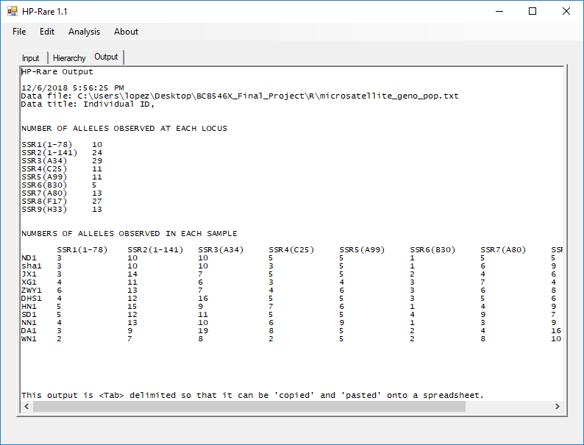
Allelic Richness and Private Allelic Richness

Slide 25
Table 2
Ours
Theirs
Locations | Na | Ar | PAr | Ho | He | Fis
Ning | 5.333333 | 4.42 | 0.05 | 0.483333 | 0.5275 | 0.102166
Sha | 5.555556 | 4.23 | 0.07 | 0.393416 | 0.561581 | 0.323446
Sui | 5.666667 | 4.59 | 0.12 | 0.339734 | 0.551027 | 0.35625
Xiang | 5.111111 | 4.32 | 0.19 | 0.229167 | 0.493924 | 0.529446
Huo | 6.444444 | 5.56 | 0.4 | 0.366667 | 0.632048 | 0.440515
DHS | 6.888889 | 5.21 | 0.53 | 0.44686 | 0.588674 | 0.234764
Hu | 6.666667 | 5.23 | 0.32 | 0.472222 | 0.590734 | 0.212705
Sand | 7.111111 | 5.86 | 0.4 | 0.412128 | 0.683157 | 0.417698
Nan | 6.666667 | 5.23 | 0.47 | 0.538012 | 0.556941 | 0.020912
Ding | 8.222222 | 6.53 | 1.5 | 0.429825 | 0.651008 | 0.390561
Wan | 5.222222 | 5.22 | 0.5 | 0.344444 | 0.539444 | 0.320547
Average | 6.262626 | 5.127273 | 0.413636 | 0.405073 | 0.57964 | 0.304455
Locations abbr. | Na | Ar | PAr | Ho | He | Fis
Ning | 5.3 | 4.418 | 0.05 | 0.483a | 0.528 | 0.109
Sha | 5.6 | 4.234 | 0.07 | 0.393a | 0.562 | 0.312
Sui | 5.7 | 4.595 | 0.15 | 0.340a | 0.551 | 0.395
Xiang | 5.1 | 4.316 | 0.19 | 0.229a | 0.494 | 0.559
Huo | 6.4 | 5.565 | 0.51 | 0.367a | 0.632 | 0.444
DHS | 6.9 | 5.212 | 0.55 | 0.447a | 0.589 | 0.252
Hu | 6.7 | 5.230 | 0.32 | 0.472a | 0.591 | 0.216
Sand | 7.1 | 5.312 | 0.27 | 0.412a | 0.683 | 0.371
Nan | 6.7 | 5.232 | 0.56 | 0.538a | 0.557 | 0.061
Ding | 8.2 | 6.527 | 1.50 | 0.430a | 0.651 | 0.353
Wan | 5.2 | 5.222 | 0.50 | 0.344a | 0.539 | 0.406
Average | 6.3 | 5.079 | 0.425 | 0.405a | 0.580 | 0.316
Notes:
Add table 2 notes

Slide 26
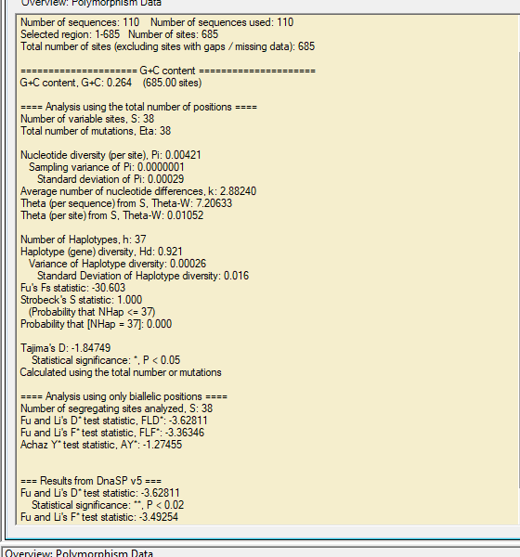
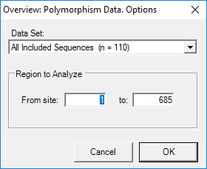
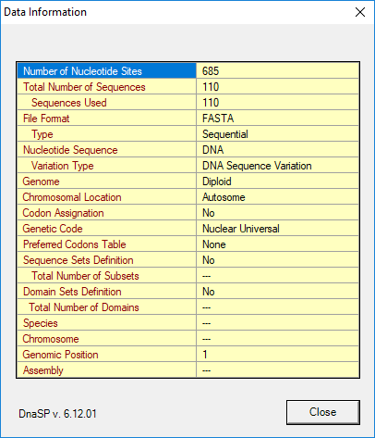
DNASP

Slide 27
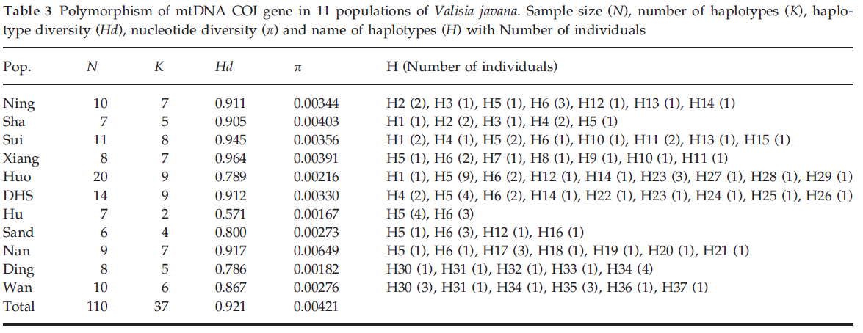

Slide 28
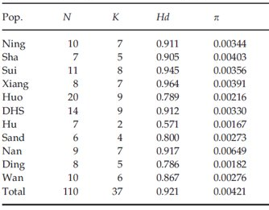
Table 3
“Polymorphism of mtDNA COI gene in 11 populations of Valisia javana. Sample size (N), number of haplotypes (K), haplotype diversity (Hd), nucleotide diversity (π) and name of haplotypes (H) with Number of individuals”
Pop. | N | K | Hd | p
Ning | 10 | 7 | 0.911 | 0.00344
Sha | 7 | 5 | 0.905 | 0.00403
Sui | 11 | 8 | 0.945 | 0.00356
Xiang | 8 | 7 | 0.964 | 0.00391
Huo | 20 | 9 | 0.789 | 0.00216
DHS | 14 | 9 | 0.912 | 0.0033
Hu | 7 | 2 | 0.571 | 0.00167
Sand | 6 | 4 | 0.8 | 0.00273
Nan | 9 | 7 | 0.917 | 0.00649
Ding | 8 | 5 | 0.786 | 0.00182
Wan | 10 | 6 | 0.867 | 0.00276

Slide 29
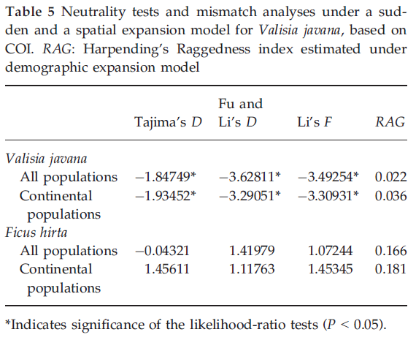
fu and li d | fu and li f | Tajima's D
-3.62811 | -3.36346 | -1.84749

Slide 30
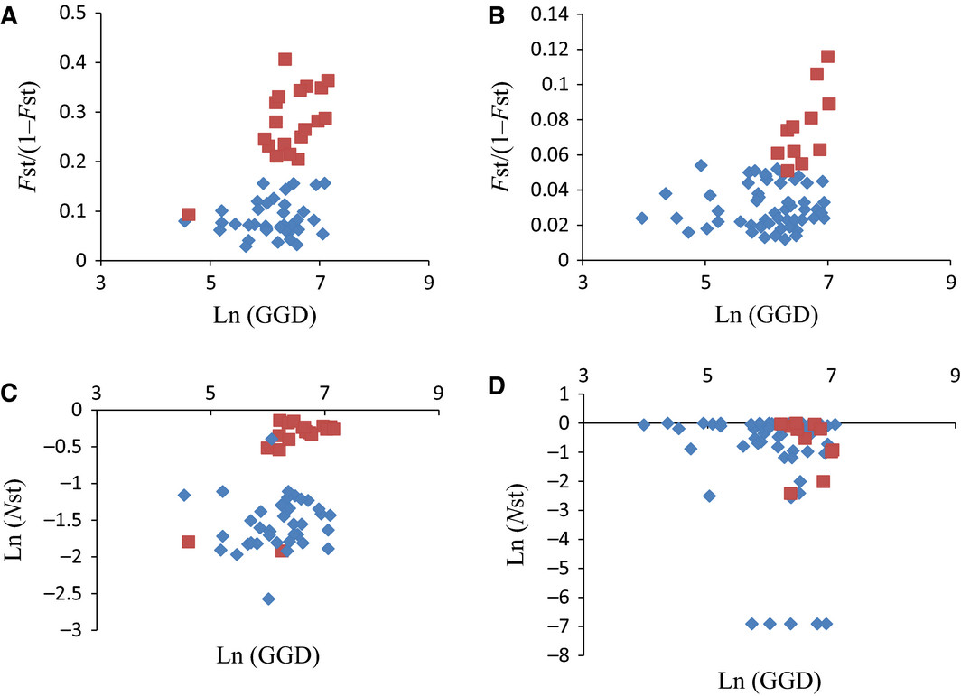
Figure 2. Pairwise genetic differentiation among populations according to geographic distance in Valisia javana (A, C) and Ficus hirta (B, D) including all populations (red squares: comparisons involving the Hainan populations; blue diamonds: comparisons between pairs of continental populations) for microsatellite data A, B and cytoplasmic DNA sequence (C: mt DNA for V. javana and D: cpDNA for F. hirta). (A) Pairwise genetic distance Fst/(1- FST) according to the natural logarithm of geographic distance (GGD; km) in V. javana. (B) Pairwise genetic distance FST/(1-FST) according to the natural logarithm of geographic distance (km) of F. hirta. (C) Logarithm of genetic distance (Nst) according to the natural logarithm of geographic distance (km) of V. javana. (D) Logarithm transform of genetic distance (NST) according to the natural logarithm of geographic distance (km) in F. hirta.

Slide 31

Notes:
note to self that Ashley misnamed the fig 2 file as fig 3

Slide 32
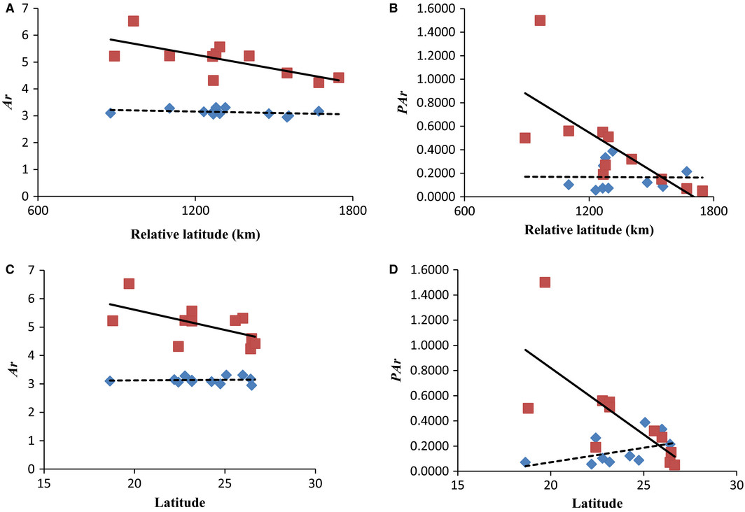
Decreasing microsatellite diversity with relative latitude in Valisia javana (red squares) but not in Ficus hirta (blue diamonds), including all populations. For V. javana, both allelic richness (Ar) and private allelic richness (PAr) decreased significantly with latitude. (A) Ar with relative latitude; (B) PAr with relative latitude; (C) Ar with latitude; (D) PAr with relative latitude.

Slide 33
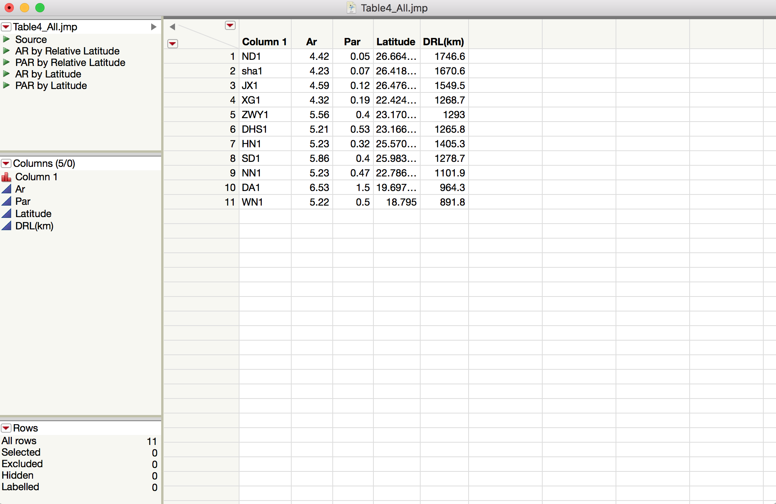
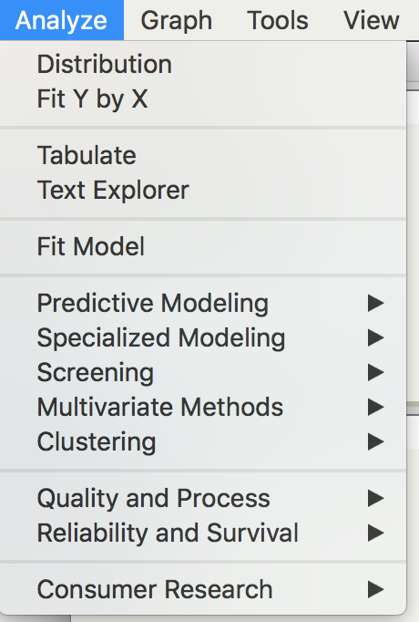
JMP

Slide 34
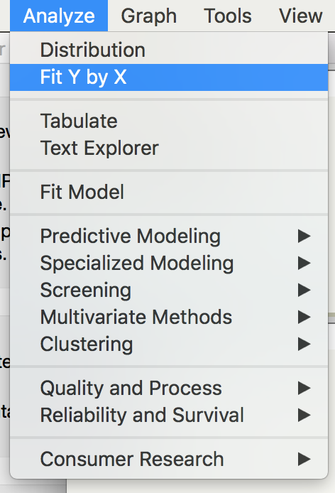
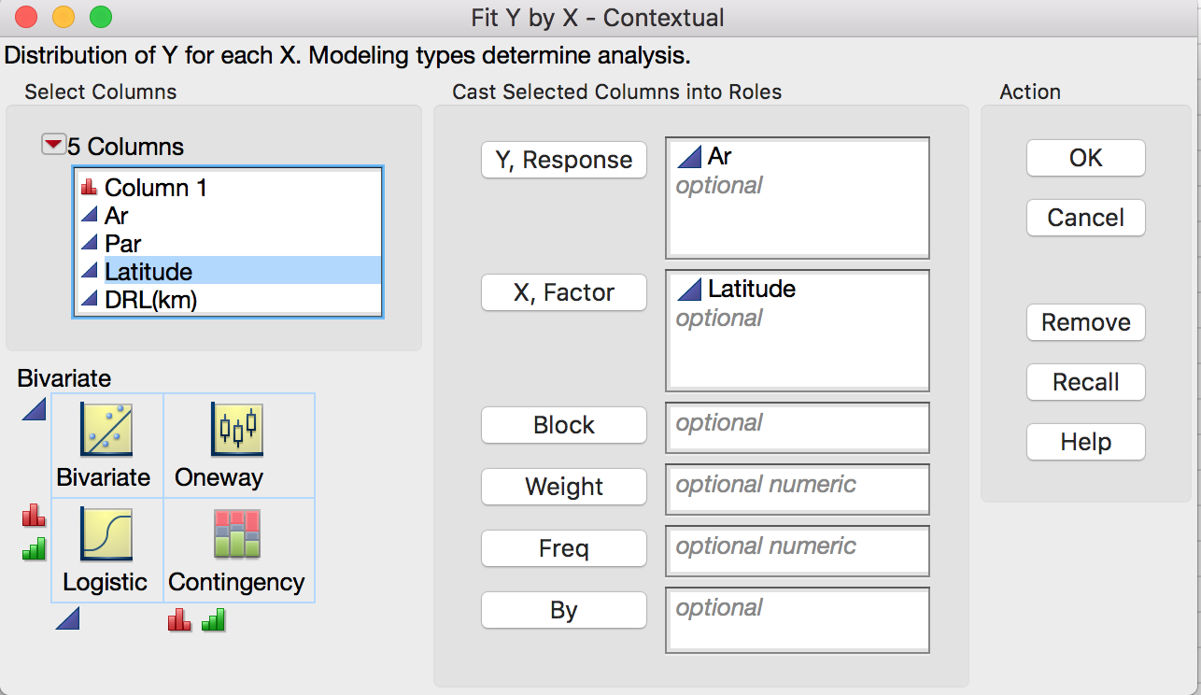
JMP

Slide 35
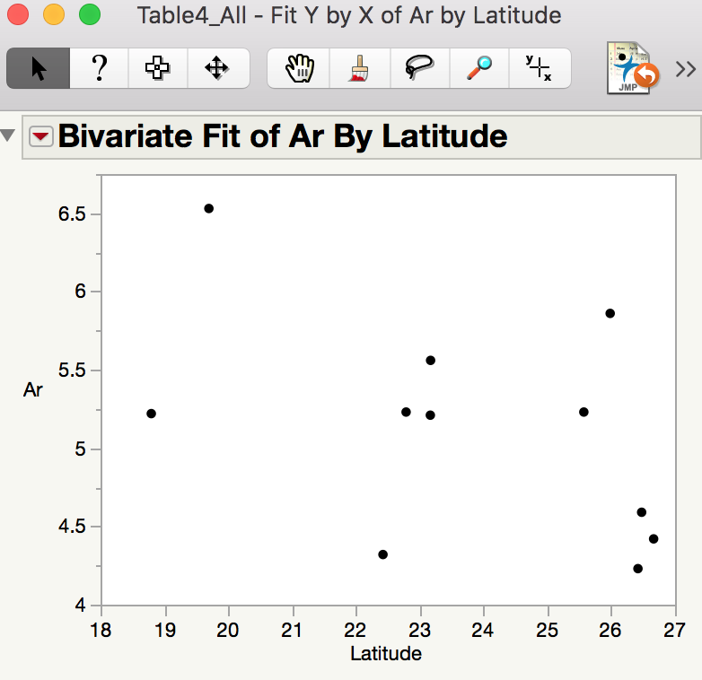
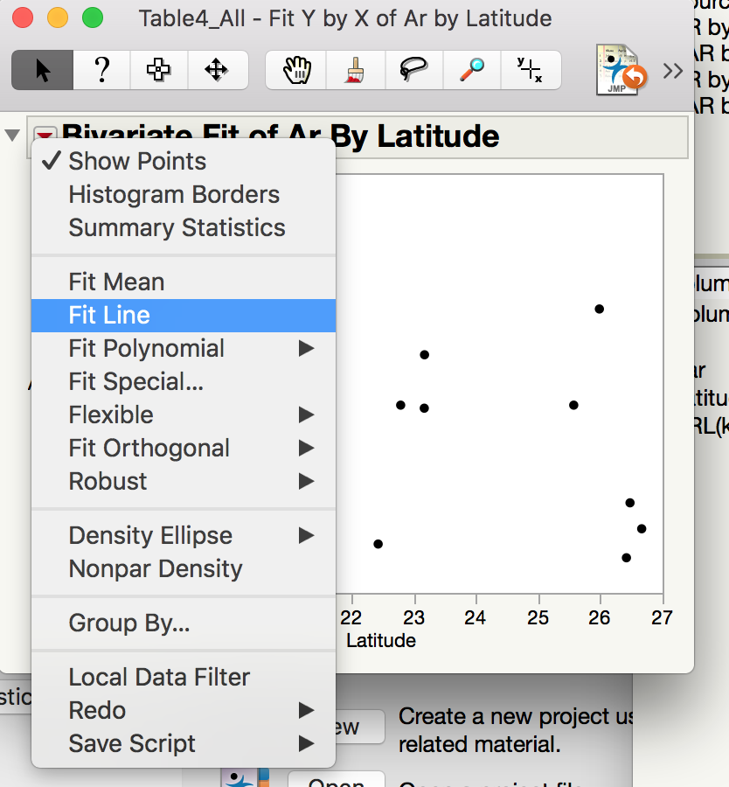
JMP

Slide 36
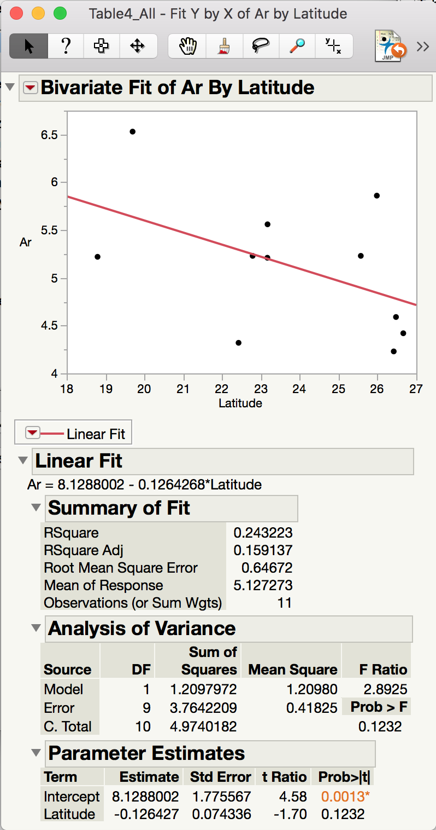
JMP

Slide 37
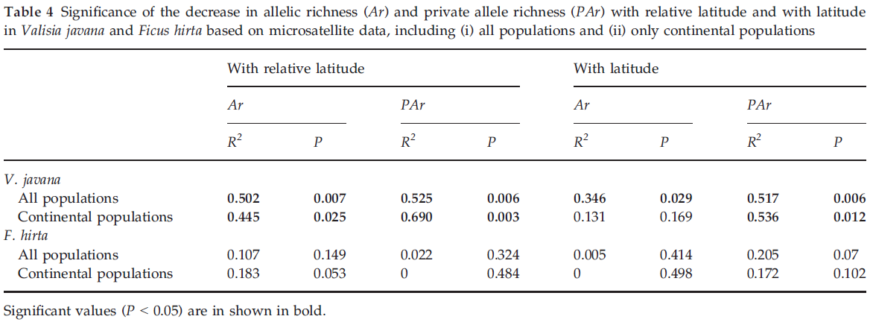
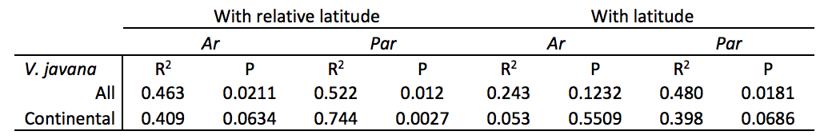

Slide 38
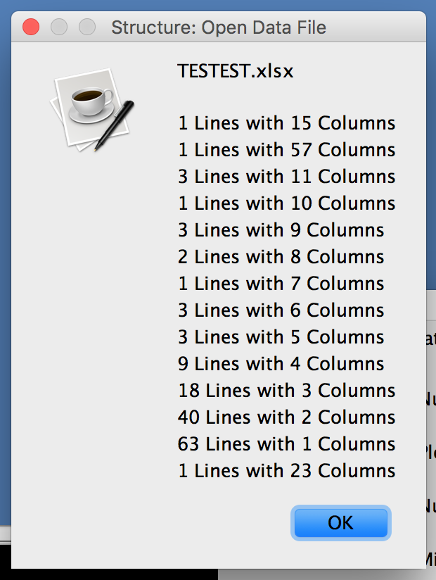

STRUCTURE

Slide 39
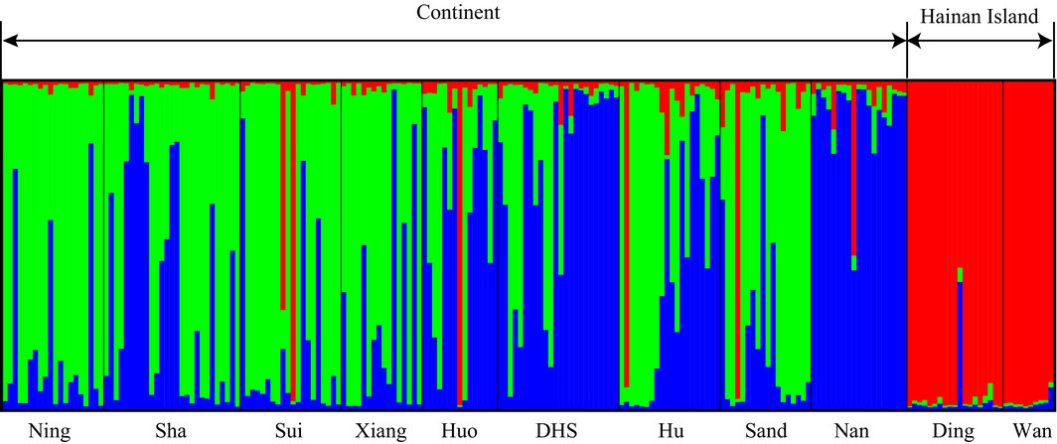
The structure analysis of Valisia javana nuclear microsatellite genotypes for K = 3 clusters separates Hainan individuals. Black lines separate individuals of different populations. Population names are labelled under the figure, with their regional affiliations (continent and Hainan Island) above it.

Slide 40
How easy was this Data to Reproduce?

